Slide 1

INNOVATION OF WEBSITE TRAFFIC ANALYSIS
DATA ANALYSIS WITH COGNOS – GROUP 5

Slide 2
Project Overview:
The Website Traffic Analysis project aims to dissect user behavior on a specified website. By delving into metrics like traffic volume, content engagement, and referral sources, the project intends to provide actionable insights for enhancing the website's performance and user experience. Utilizing web analytics tools, the analysis will cover both desktop and mobile traffic over a defined time period.

Slide 3

Ecommerce websites data collection And Analysis:
Google Analytics, once configured so that to communicate correctly with the eCommerce platform, permits to collect online shopping data and information about visits putting them in relation to each other. Also in this case we have at disposal lots of metrics and statistics, among the most critical key performance indicators (KPI) we see:
Conversions. Number of visits that have produced at least one purchase;
Conversion Rate (CR). Percentage of visits converted into sales;
Average Order Value (AOV). Average value of online sales;
Value per Visit. The average value for each website visit, calculated by dividing revenue by number of visits;
Cart Abandon Rate during the buying procedure;
Traffic Sources.

Slide 4
This web traffic data and statistics mining stems from three main needs:
Monitor and analyse website visits (web analytics);
On-site analysis. Measure visitors number and behaviour, analyse interactions with brand,interpret digital marketing strategies results;
Off-site analysis. It focuses on off-site web traffic. It measures potential audience and opportunities offered by the online market.
Analyse traffic generated by social media (social analytics);
Carrying out online reputation audit and sentiment analysis (market sentiment and brand reputation).

Slide 5
Objectives:
Traffic Volume: Determine the total number of visitors to the website over a specified period.
User Behavior: Analyze how users navigate through the website, including pageviews, session durations, and bounce rates.
Content Engagement: Identify the most popular pages, blog posts, or products, and measure user interactions (e.g., likes, comments, shares).
Traffic Sources: Determine where the traffic is coming from (e.g., search engines, social media, direct links).
Conversion Tracking: Monitor and analyze the conversion rate, tracking specific goals such as sign-ups, purchases, or form submissions.
Geographic and Demographic Data: Understand the geographical location and demographic profile of website visitors.
Technology Usage: Analyze the devices, browsers, and operating systems used by visitors.
Referral Analysis: Examine which websites or platforms refer traffic to the target website.

Slide 6
Methodology:
Utilize web analytics tools such as Google Analytics, Adobe Analytics, or custom tracking scripts to collect relevant data.
Apply data visualization techniques to present findings in an easily understandable format (e.g., charts, graphs, dashboards).
Conduct a comparative analysis to identify trends, anomalies, and areas for improvement

Slide 7
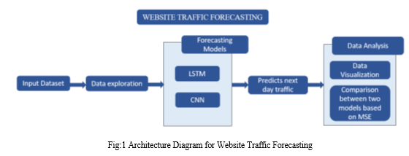
The flow of the project is explained in detail in the architecture diagram. We start with a dataset containing the features hour index and sessions. To identify trends, we examine the data. Create training and validation sets from the dataset. Two models, LSTM and CNN, were created, using the training data to feed the models and the validation data to test the models. To compare the performances of the different models, determine the mean square error. Use line graphs with the hour index on the X-axis and the sessions on the Y-axis to compare the performance of the two models.

Slide 8
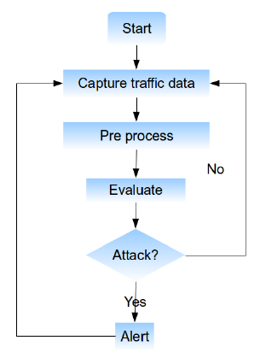
FLOW CHART:

Slide 9
Conclusion:
The main goal of our research is to develop a consistent forecasting model for predicting future web page traffic. Time series prediction of web traffic can be performed more efficiently and accurately using recurrent neural networks with long-term memory and CNN.
LSTM RNN brings more efficiency to our system. Moreover, despite the limited amount of data we had available, we achieved quite good results in training the LSTM. In future work, we plan to deepen the extraction of hidden patterns to improve the efficiency of the LSTM and to study how human behavior affects web traffic.

